Slide 1
Strategy and Management Control system
Week 01: Lecture 02

Slide 2
Tasks Involved in Strategic Management & MCS
Defining business and stating a mission
Setting measurable objectives
Crafting a strategy to achieve objectives
Implementing a strategy
Evaluating performance of the strategy, reviewing new developments and taking corrective action

Slide 3
The essence of strategy of the organization
Perspective strategy or rational view
An emergent view

Slide 4
Rational perspective

Slide 5
Developing a Mission & Objectives
An organization’s Mission
Reflects management’s purpose of operating the business
Provides a clear view of what the organization is trying to accomplish for its customers
Indicates intent to take a business position
An organization’s Objectives
Convert the mission into performance targets
Track performance over time
Must be achievable
Two types
Financial – outcomes that relate to improving financial performance
Strategic – outcomes that will result in greater competitiveness & stronger long-term market position

Slide 6
BBC’s purpose statement
“To educate, inform and entertain”
Walt Disney’s Purpose Statement
“To make people happy”

Slide 7
Management accounting and strategy
• Objectives
- Specific statement of what the organisation aims to
achieve, often quantified and relating to a specific period of time (SMART)
• Strategies
-
Strategy is the direction and scope of an organisation over the long term which achieves advantage for the organisation through its configuration of resources within a changing environment to fulfil stakeholder expectations.
G. Johnson and K. Scholes Exploring Corporate Strategy 6th edition

Slide 8
The essence of strategic management-a perspective view
• Major decisions
- What business will we operate in?
- What are our basic directions for the future
- What systems and structures should we have in place
to support our strategies?
• Corporate strategy
- Decisions about the types of businesses to operate in, which businesses to acquire and divest, and how best to structure and finance the organisation

Slide 9
What business are you in?

Slide 10
If DSI confines itself footwear business, can they offer tyres , tubes, schoolbags?

Slide 11
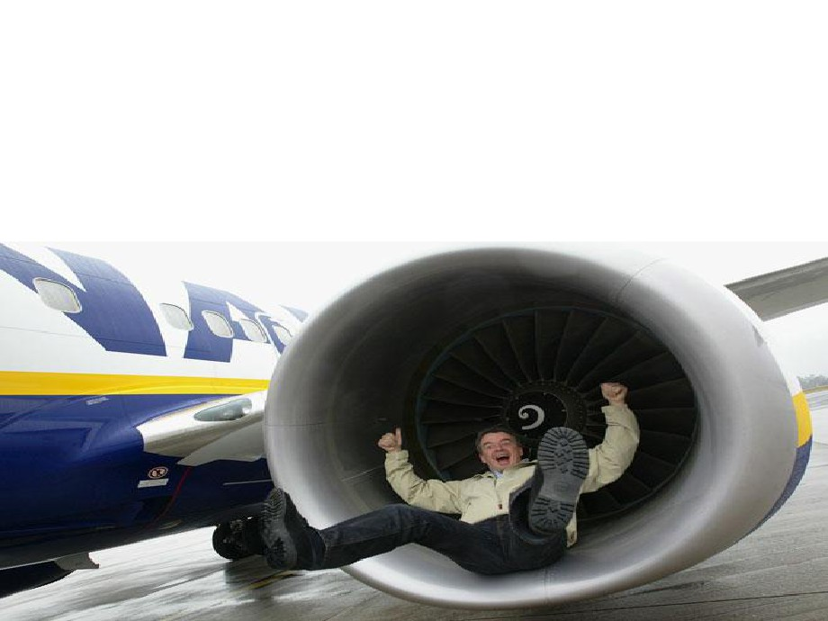
What business are you in?
If you want to travel from London to Manchester, you can choose from the train, coach, car or
aeroplane, so what business should Ryanair be in?

Slide 12
An emergent view
Emphasize the uncertainty of the future and suggest that setting out identify purpose and a single strategy and then develop a complete strategic plan may be fruitless task

Slide 13
What if you don’t redefine your business purpose

